Slide 1
CSC1004 Tutorial 5 Yan Ke

Slide 2

An intro to games
An example of

Slide 3
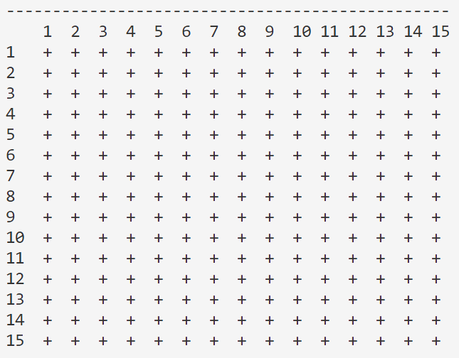
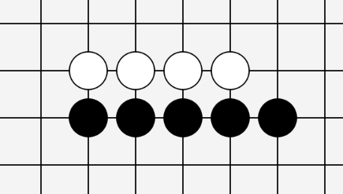
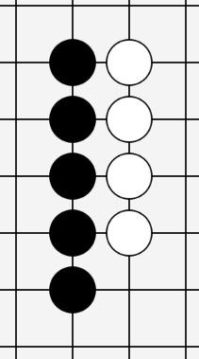
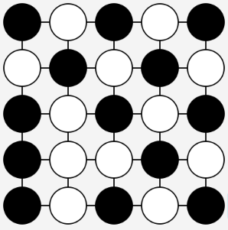
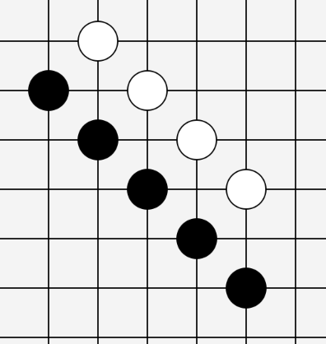
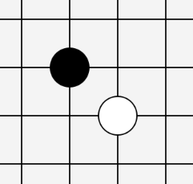
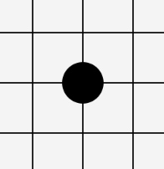
Gomoku Game
Game Over
15×15 Chess Board
One Player Wins (Black in This Example)
A Draw (No One Wins)
(e.g. we
suppose
the board
is scaled
down
to be
5×5)
Horizontally
All positions for stones (chess)
are taken without reaching
the winning condition.
Black Plays First
Player 1, place first
No Overlap
vertically
Already Placed
It’s not allowed
to place a stone
on some existing
stone.
(Also, it’s not allowed
to place any stone
If the game is over)
Player 2,
place later
Five stones in a line
Gomo
(and the stones should be placed on the intersection of the lines of the board)
diagonally
五目

Slide 4
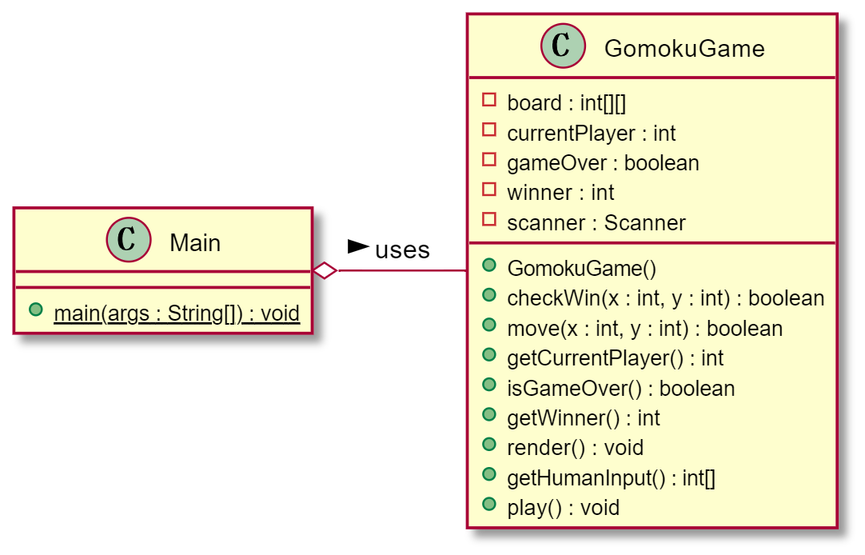
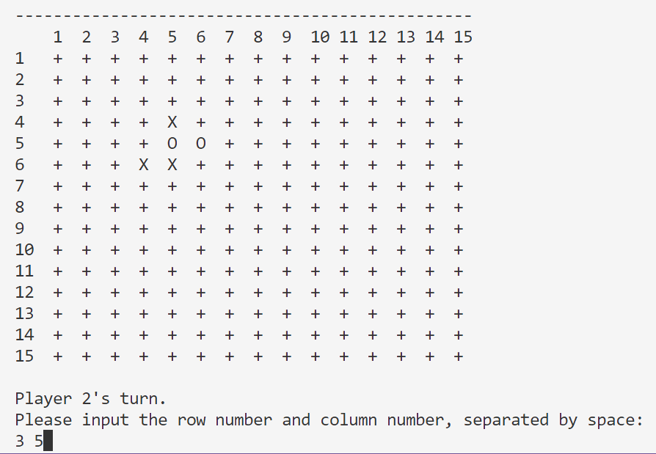
Simplest Version: Iteration 1
Question 1: If you are required to implement a simplest version of Gomoku Game, how would you implement it?
Potential Answer: I shall cover the basic game rules with console/terminal input and output as the game interface.

Slide 5
Simplest Version: Iteration 1
Class GomokuGame
The main() function of Main class holds one instance
Constructor()
Call the play() function to start the loop
The While loop in the play() function
gameOver?
Yes
No
render()
x,y = hunmanInput()
> Show the result
> Close input flow
move(x,y)
Use checkWin() to modify gameOver

Slide 6
Simplest Version: Iteration 1
Initialize the chess board
Initialize other variables like currentPlayer, gameOver, winner
Initialize the input scanner (optional)
GomokuGame()
i.e. the constructor
One may use another classname “GomokuEnv” for
the meaning of some “environment”.
Keep receiving the input command, execute it and render the chess board
Provide hint when the move is invalid
When the game is over, show the results (and close the input stream)
play()
Use blank space as separator
Two integers are absorbed
HumanInput()
Maybe the most proper name should be
“placeAStoneAt(x,y)”
Not allow to place if the game is over
Not allow to place if the position is out of boarder
Not allow to place if the position is used
Update the position to be used by current player
Update gameOver and winner if the game is over with checkWin()
Anything missed for game over checking (see some page later)?
Switch the current user
move(x, y)
i.e. the place() function

Slide 7
Simplest Version: Iteration 1
Better show the row and column number as numerical input is used
Denote “+” for some unused position, “X” for the black stone, and “O” for the white stone
Loop over the rows and columns to print all those required things
Alignment should be considered
render()
Note: actually the whole render() function is optional as we’d use JavaFX for rendering in the future, but we need such function for the whole
program to be “complete” so that we can make some tests and ensure that our core components work properly, to avoid messing up with
those future GUI codes.
Separation line
row numbers
Column numbers
Player 2’s Stone (white)
Position not placed
Player 1’s Stone (black)
Input hint
User Input

Slide 8
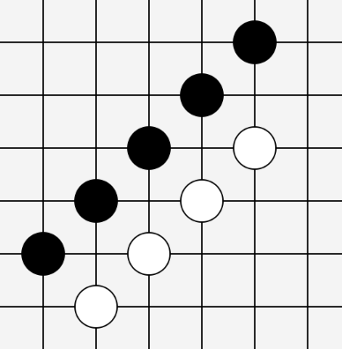
Simplest Version: Iteration 1
Question 2: How to efficiently check whether some player wins?
Potential Answer: Do not check each state, or say the whole board, as it would be complex to traverse the board and check whether there exists some five-stones-in-one-line; instead, as long as each time when some stone is placed, the 8 directions (why 8?) starting from such stone is checked, there wouldn’t be any winning condition missed, and the computational cost each time is low [Error: this is some incomplete implementation].
{0, 1, -1} × {0, 1, -1} / (0,0)
8 directions in all

Slide 9
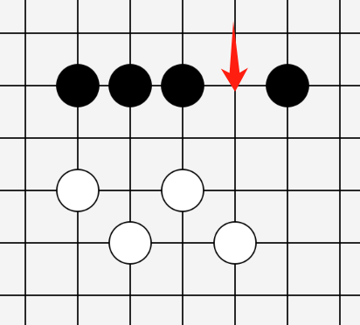
Simplest Version: Iteration 1
Question 2: Any counter example for the former algorithm? Anything missed?
Potential Answer: Yes, actually the former algorithm could miss some case that “some 5-stones-in-one-line just lack
Some stone somewhere in-between of a line while such place is filled later“. We may check the four direction-line
Instead, with each line including two directions. As long as some placement stretching on some line (in two opposite directions) reaches 5-stones-in-one-line, we can tell that someone wills.
The former algorithm can not detect the winning
condition for player 1 when the black stone is
placed on the position that the red arrow points to
4 direction-lines (positive direction & negative direction)

Slide 10
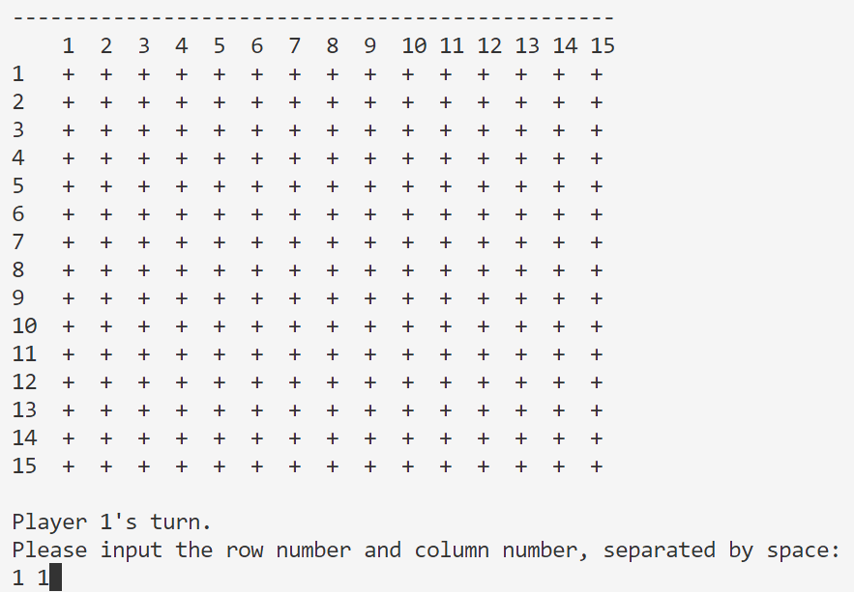
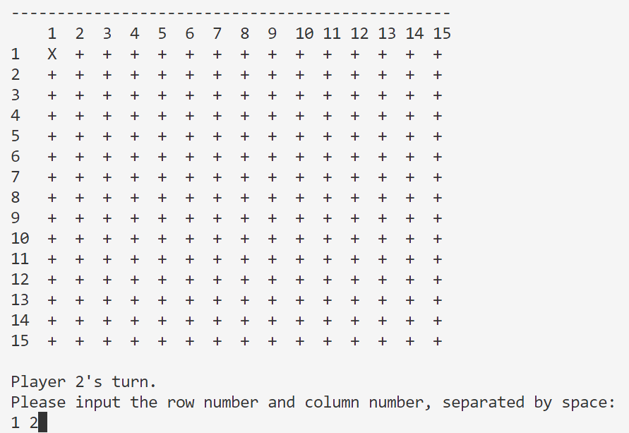
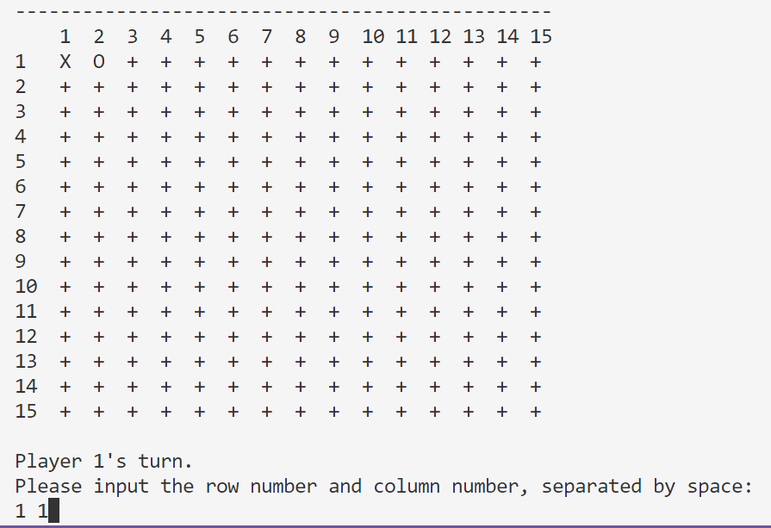
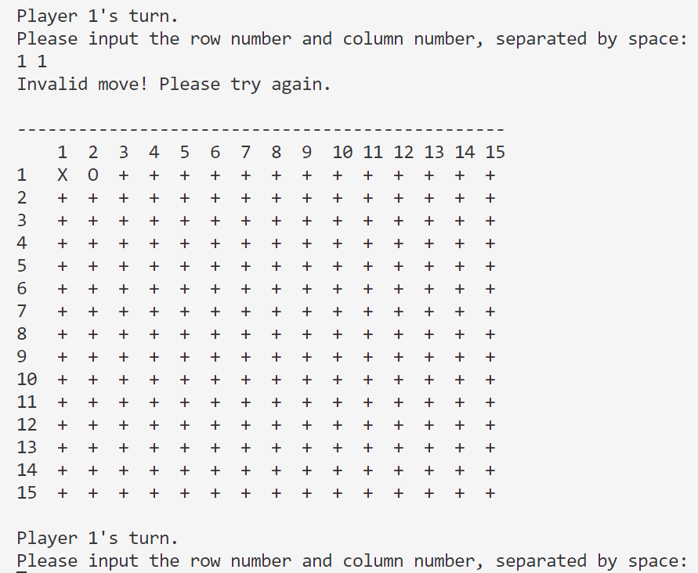
Sample Input / Output
① Initialized board
Player 1 picks (1,1)
② (1,1) shown with “X”
Player 2 picks (1,2)
③ (1,2) shown with “O”
Player 2 picks (1,1)
④ Invalid hint provided
Player 1 picks again

Slide 11
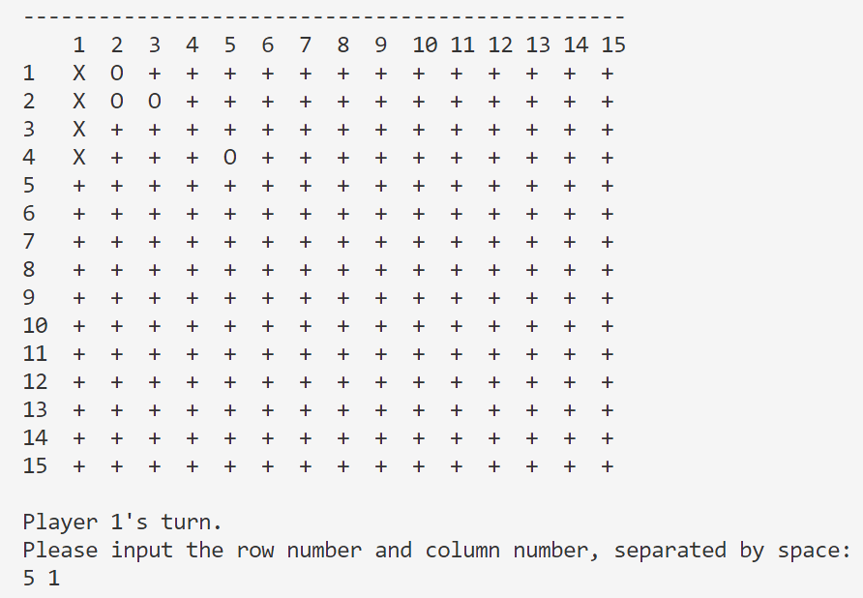
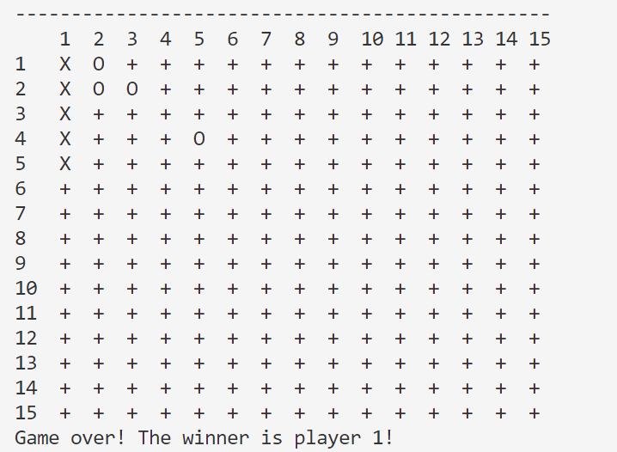
Sample Input / Output
Player 1 picks (4,5) and forms five-stone-in-one-row, and the console show that the winner is Player 1.

Slide 12
Simplest Version: Iteration 1
Question 3: What is missed in the game over checking when executing the move() function?
Potential Answer: The condition of “draw” is not considered. Maintain the total number of moves and check whether it reaches the maximum limits is more efficient than checking the whole board (to be shown later).
Maintain the total number of moves and the maximum allowed number of steps based on board size
Increase the record for total number of moves each time there is some feasible move
Set the game to be over if there isn’t any winning condition encountered and the total number of moves reaches the limit

Slide 13

THANK YOU
林天麟 教授
香港中文大学（深圳）
机器人与人工智能实验室
WeChat: tinlunlam

